Slide 1
Group project
TV-tennis
Novosibirsk State University
Faculty of Information Technology
Completed:
A. A. Potapova
(1st year, group 21216),
P. I. Dzyuba
(1st year, group 21216)

Slide 2
CONTENT
ABOUT THE GAME
TECHNICAL LIMITATIONS
THE FORMULA OF AN INTERESTING GAME
INNOVATIONS
CONCLUSION

Slide 3
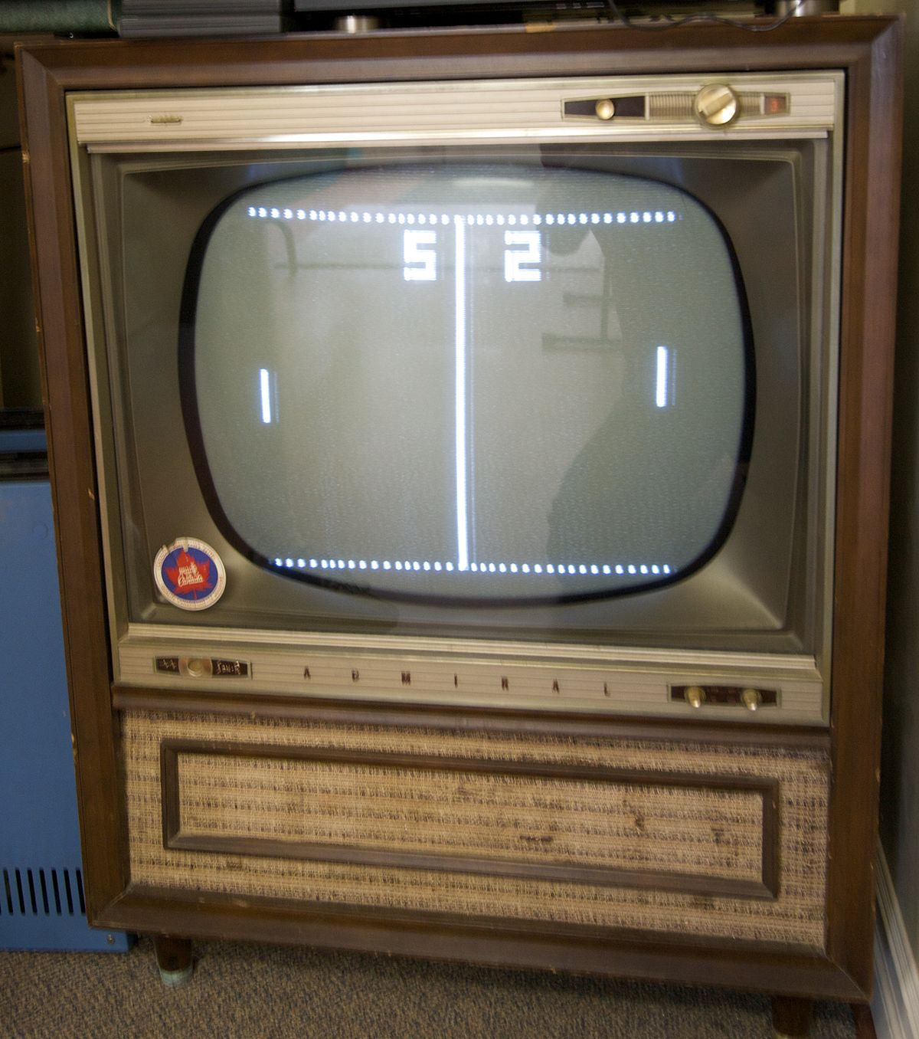
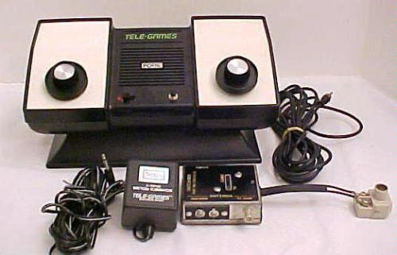
ABOUT THE GAME
TV tennis (one of the names is pong) is one of the first and most famous games in the world. The essence of the game is to move the bat and hit the ball on the opponent's field. The round is considered won if the ball touches the opponent's wall.

Slide 4
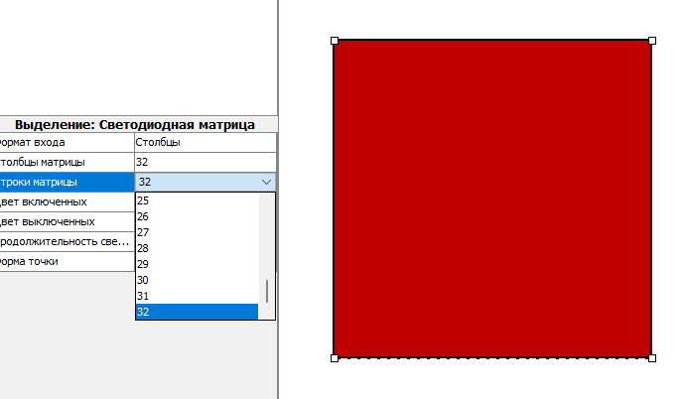
TECHNICAL LIMITATIONS
Since we need a mouse to control the joystick, we cannot use 2 joysticks at the same time.
One mouse - 2 joysticks =(

Slide 5
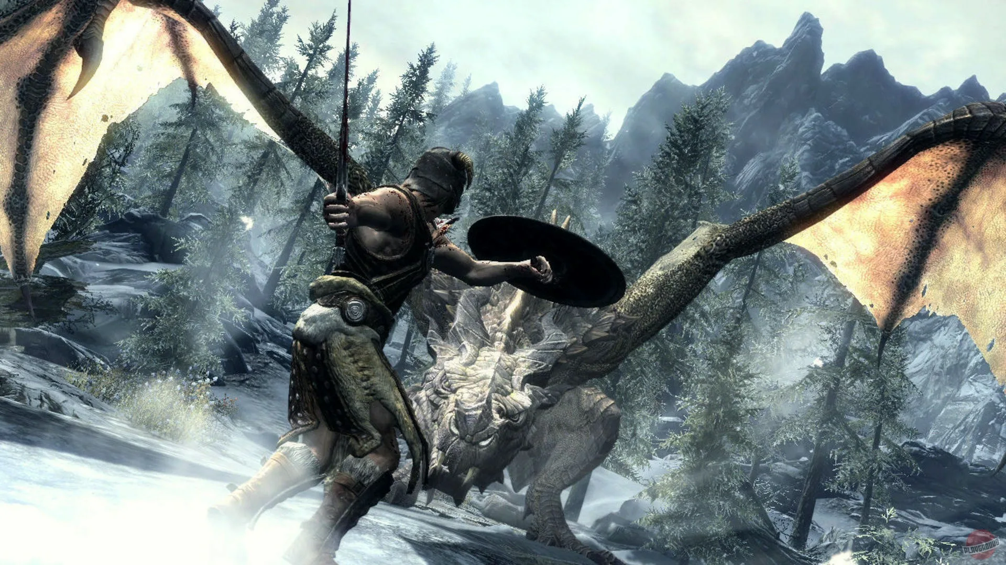
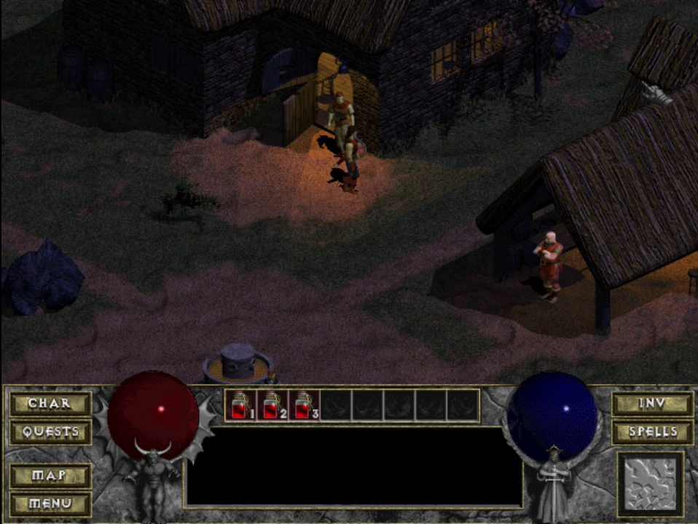

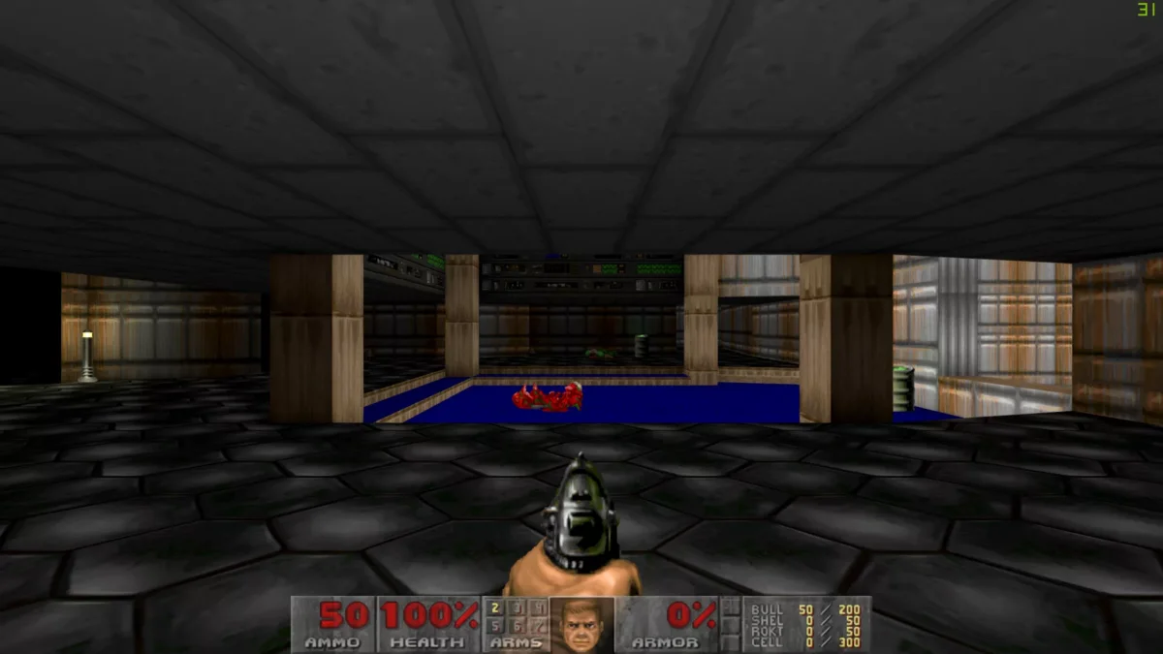
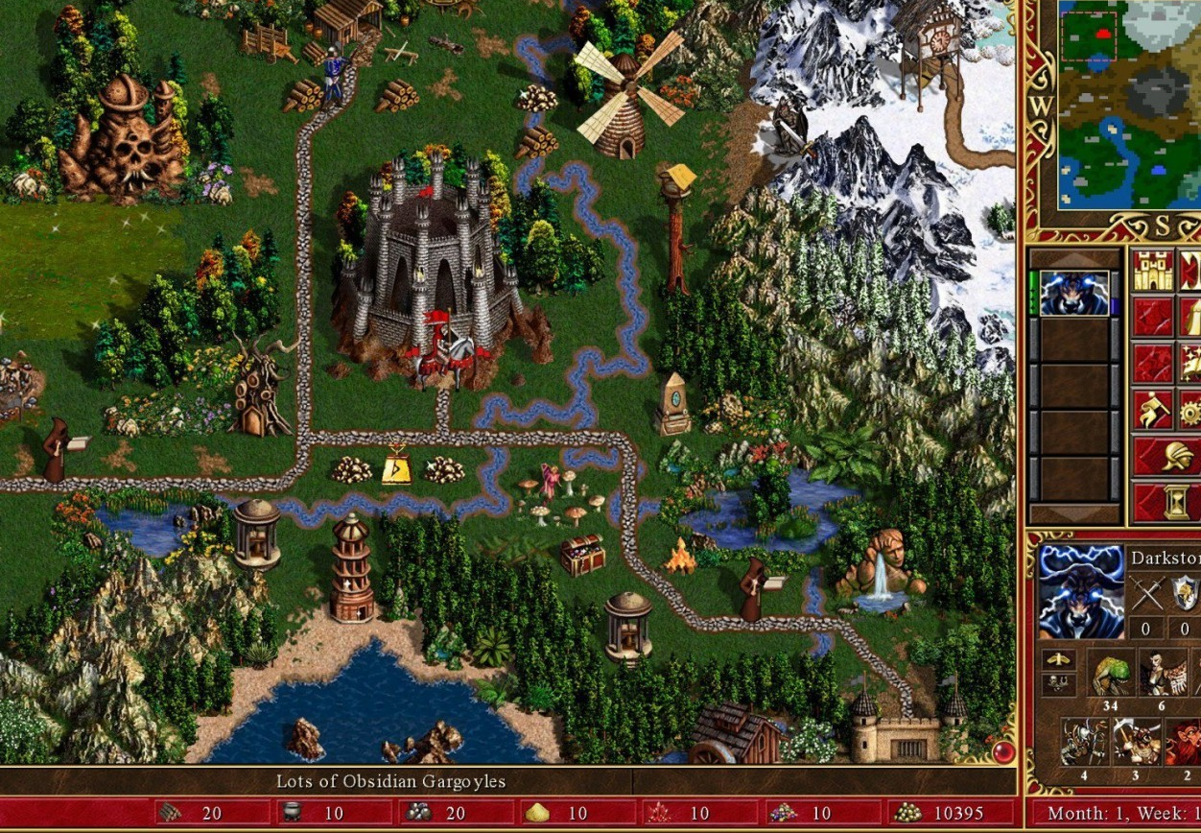
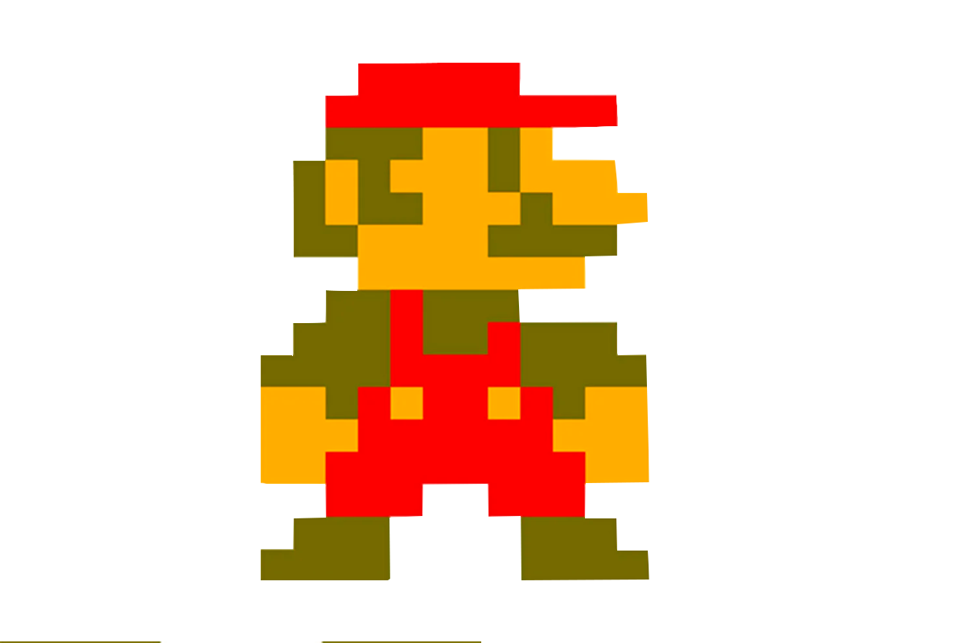
THE FORMULA OF AN INTERESTING GAME

Slide 6
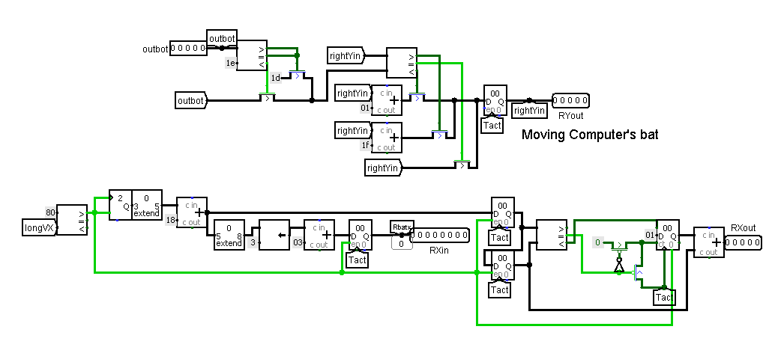
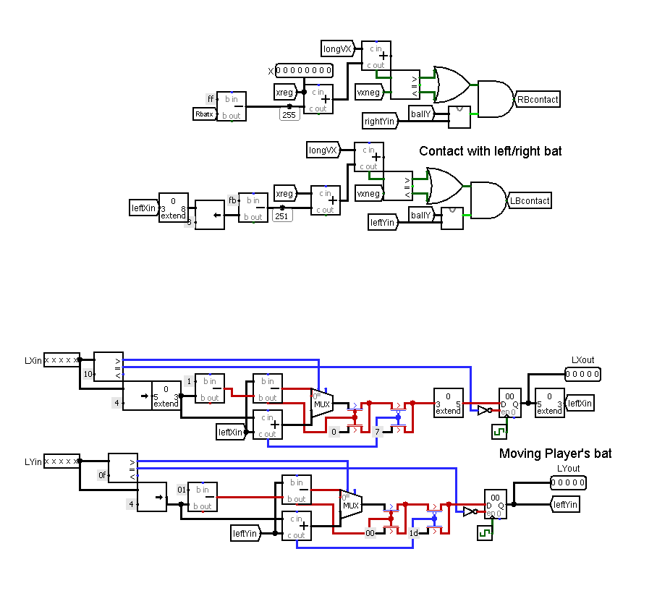
INNOVATIONS Сhange №1
Modified schemes:

Slide 7
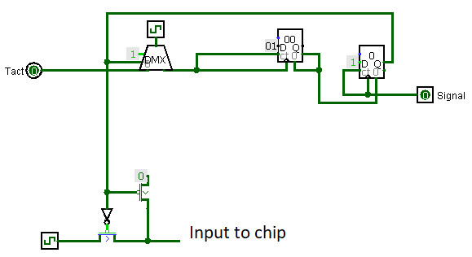
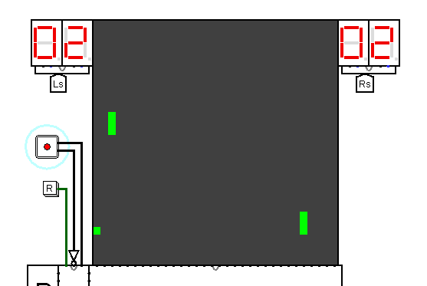
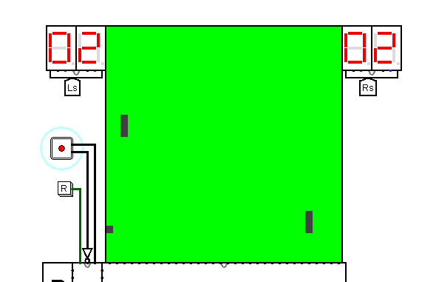
INNOVATIONS
Сhange №2

Slide 8
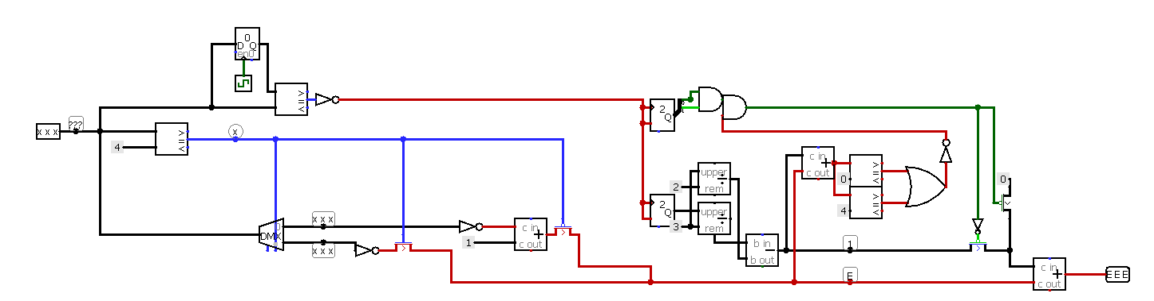
INNOVATIONS
Сhange №3
Possible directions of the ball movement:

Slide 9
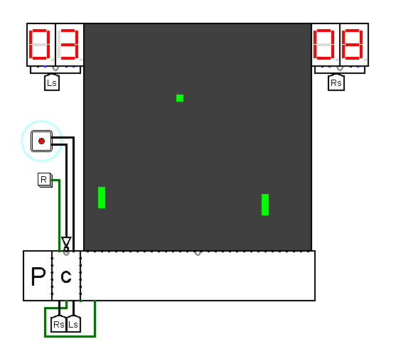
CONCLUSION

